Slide 1
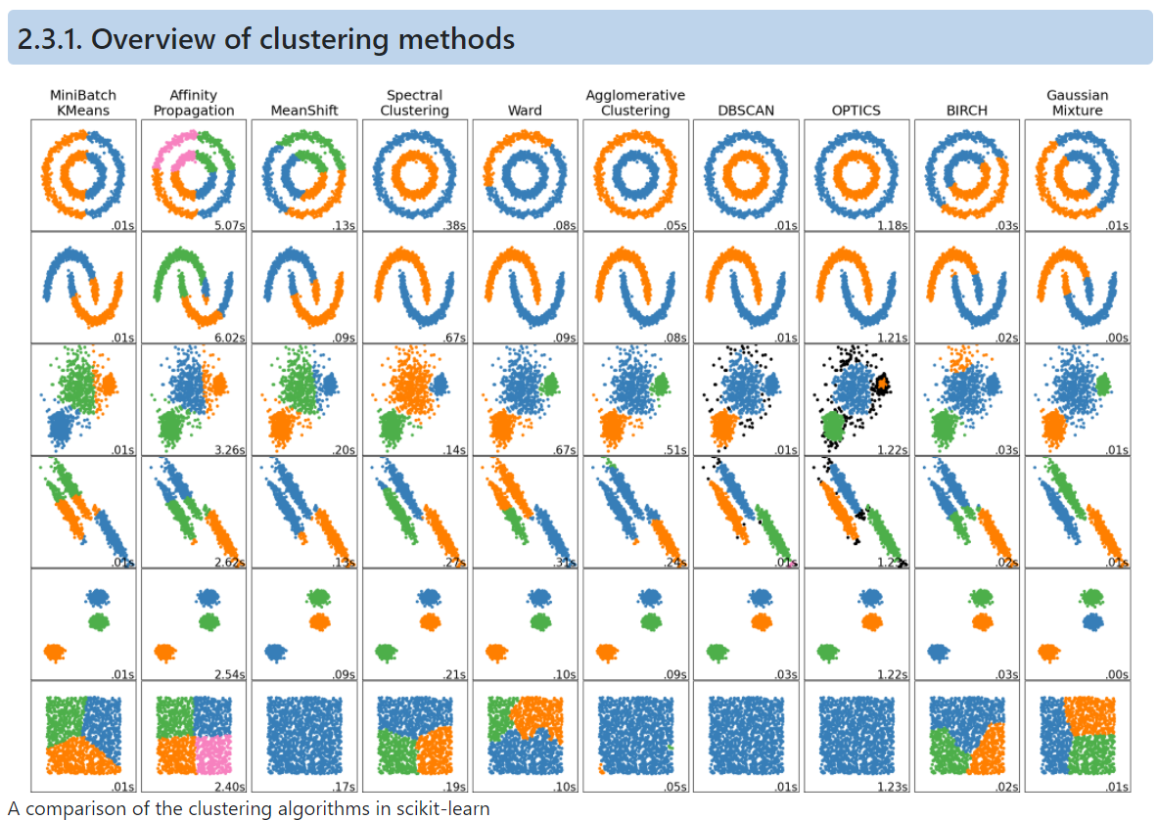
Clustering Algorithms
Part-1

Slide 2
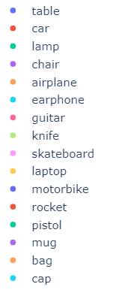
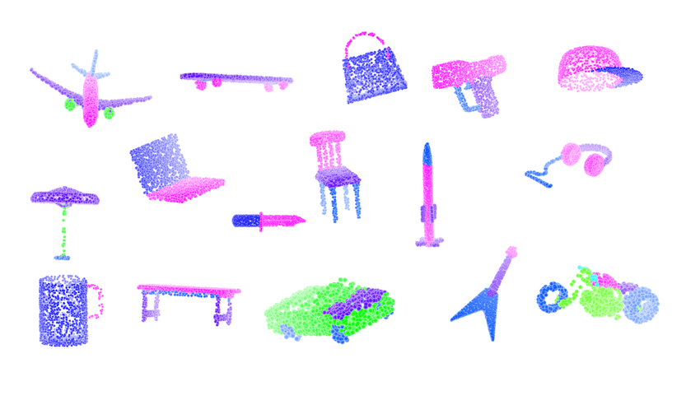
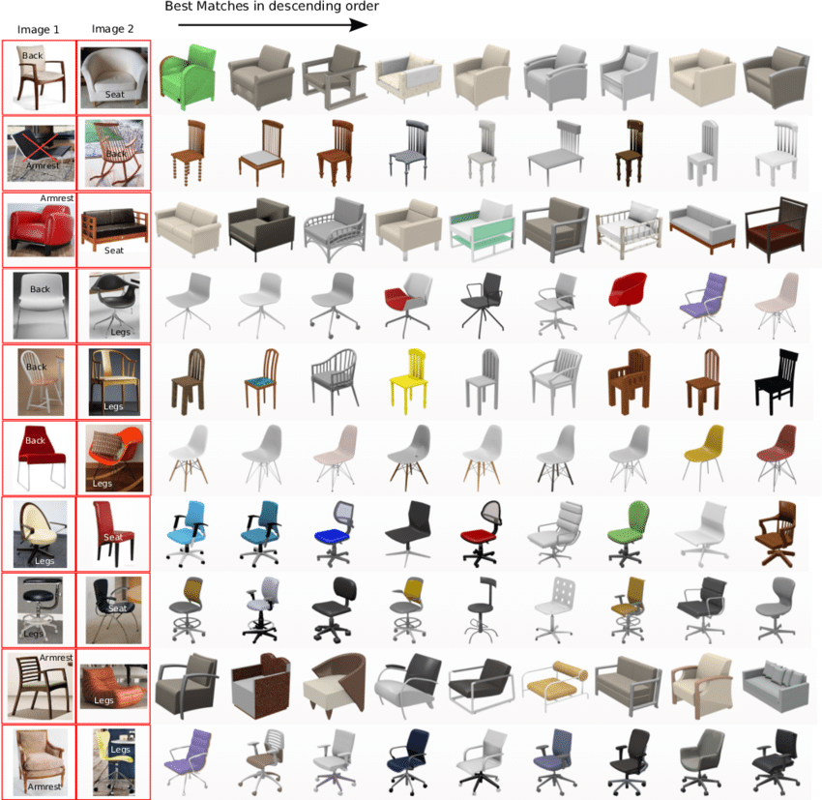
Motivation
Shape-net dataset
Problem: 3D Model Retrieval
Given a 3D Model find the most similar models
Generate shape representations of these 3d models
Perform clustering on the shape representations
Ranking of the 3D models within a particular cluster
Given a 3D model, retrieve top-n ranks of 3D model

Slide 3
Agenda
01
Overview of Clustering
04
Affinity Propagation
Types of clustering
Introduction
Pros and Cons
02
K-Family Algorithms
05
Spectral Clustering
K-Means
K-Medoids and more
Introduction
Pros and Cons
03
Mean Shift Algorithm
Short Introduction
Pros and Cons

Slide 4
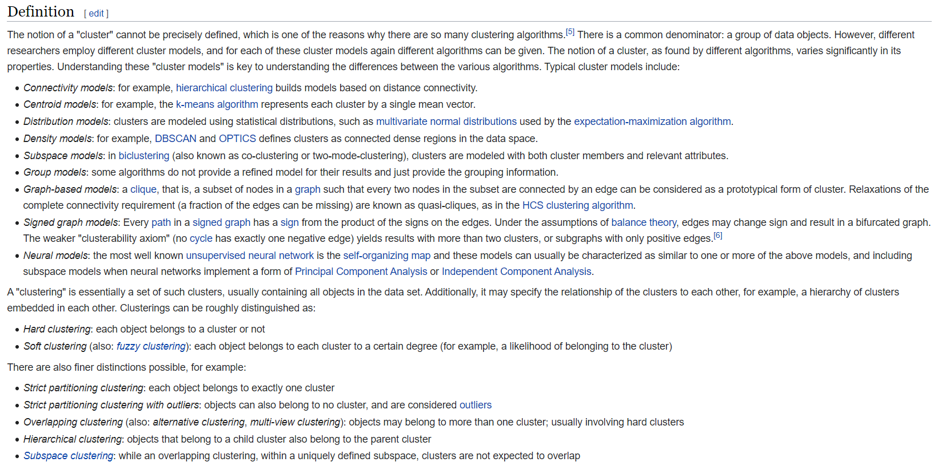
What is clustering?

Slide 5
Many Forms of Clustering
Clustering
Centroid Based Clustering
Hierarchical Based Clustering
Density Based Clustering
Graph Based Clustering
Clustering
Hard Clustering
Soft Clustering

Slide 6
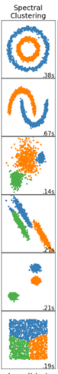
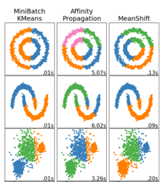
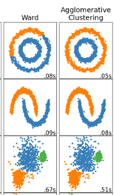
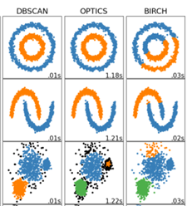
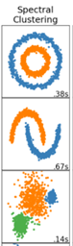
Types of Clustering
Clustering
Centroid Based Clustering
Hierarchical Based Clustering
Density Based Clustering
Graph Based Clustering

Slide 7
01
Centroid Based Clustering

Slide 8
Family of K-Algos
K-Algos
K-Means
K-Median
K-Medoids
K-Modes
K-Prototype

Slide 9
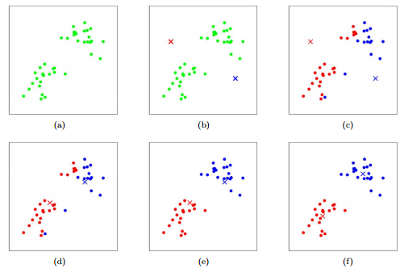
K-Means (Lloyd’s) Algorithm
Specify the number of clusters to assign (k)
Randomly initialize k centroids
Loop :
Assign each point to the closest centroid
Compute new centroid (mean) of each cluster
Until the centroid position do not change

Slide 10
K-Median
Instead of using mean for each cluster to determine the centroid, one uses median.
Has the effect of using 1-norm distance metric instead of using squared 2-norm distance metric (used by k-means)
This method is more robust to outliers since median is more robust than mean

Slide 11
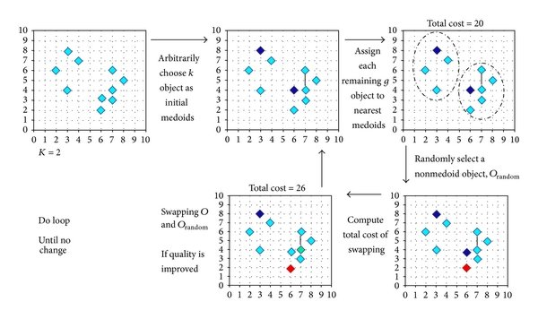
K-Medoids Algorithm
Select k points as the initial representative medoids
Loop :
Assign each point to the closest medoid
Randomly select a non-representative object (medoid)
Compute the cost of the cluster after swapping the object
If cost decreases, then swap them to form the new set of medoids
Until the convergence criteria
Partitioning Around Medoids (PAM)
CLARANS

Slide 12
K-Medoids Properties
Centroids in k-means, which represents the cluster are virtual points, whereas, in case of medoids they represents points from the actual dataset which represents the clusters. Hence providing greater interpretability of clusters
K-Means is sensitive to outliers, since one outlier may pull the centroid in its direction. K-Medoids however, are robust to them
K-medoids can be used with arbitrary dissimilarity measures, whereas K-Means requires Euclidian distances for efficient solutions
K-Medoids has been show to perform better than K-Means for Big Data - (PDF) Analysis of K-Means and K-Medoids Algorithm For Big Data (researchgate.net)
Algorithm is implemented in sklearn-extra

Slide 13
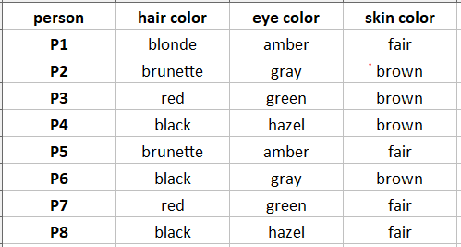
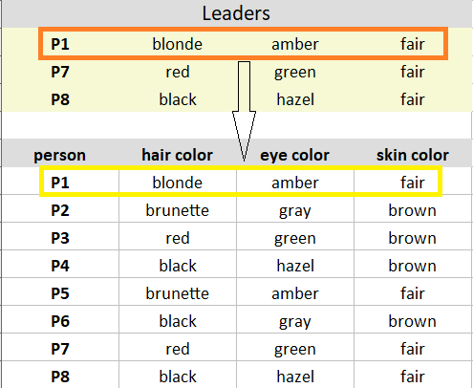
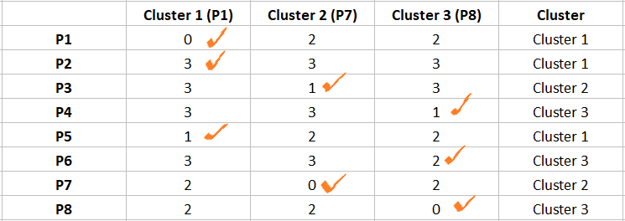
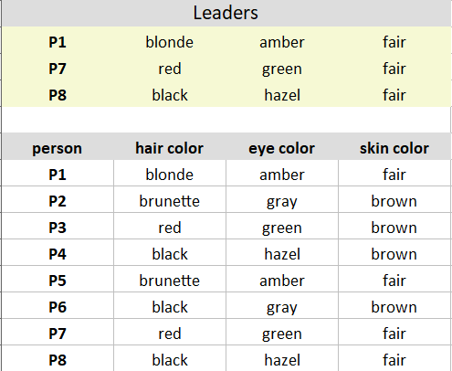
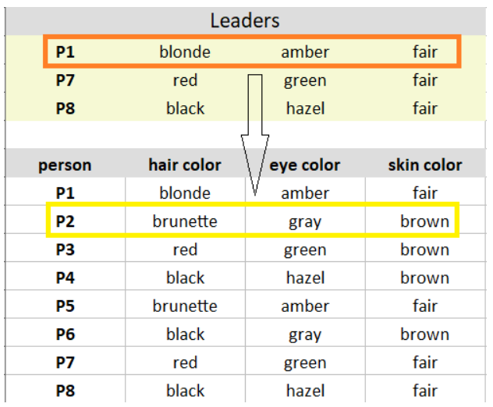
K-Modes
K-Modes clustering is used when you have categorical data
The notion of distance metric is the “mode” of the numbers
https://www.analyticsvidhya.com/blog/2021/06/kmodes-clustering-algorithm-for-categorical-data/

Slide 14
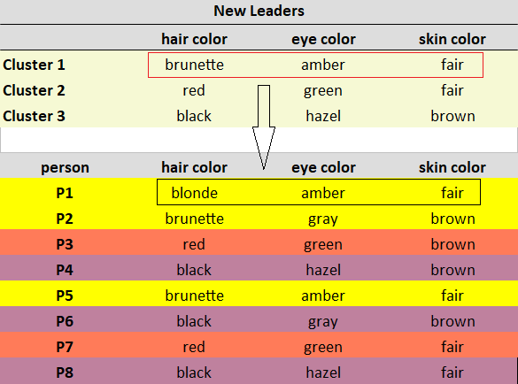
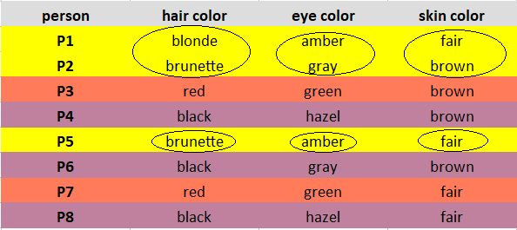
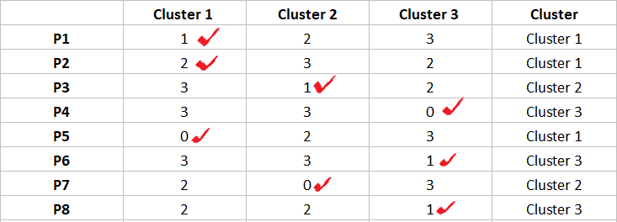
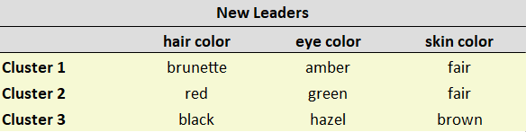
K-Modes Continued
Algorithm is implemented in kmodes package

Slide 15
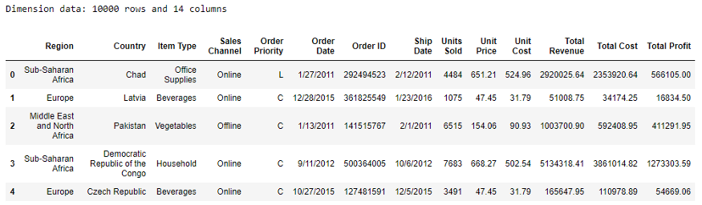
K-Prototype (Heterogeneous Data)
Algorithm is implemented in kmodes package
Used when we have mix of continuous and categorical data
K-Prototype solves this using K-Means for continuous data and K-Modes for categorical data
The dissimilarity measure is the weighted combination of Euclidian distance and the dissimilarity of modes
This problem can be solved using other types of clustering techniques like
Gower’s distance + K-Medoids
Kamila
LCA
LCM
MixMode
https://www.nature.com/articles/s41598-021-83340-8
https://towardsdatascience.com/the-k-prototype-as-clustering-algorithm-for-mixed-data-type-categorical-and-numerical-fe7c50538ebb

Slide 16
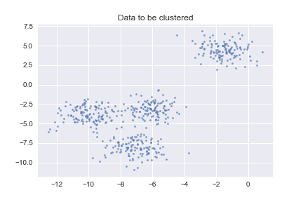
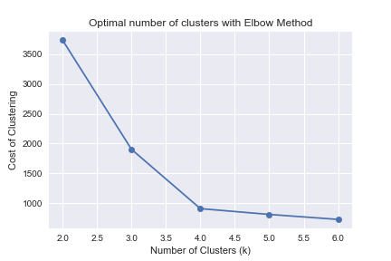
How to find K? – Elbow Method

Slide 17
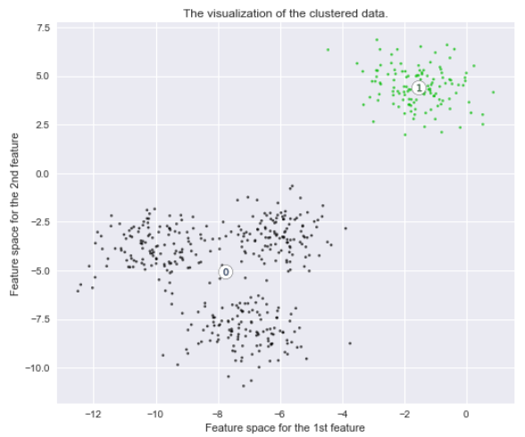
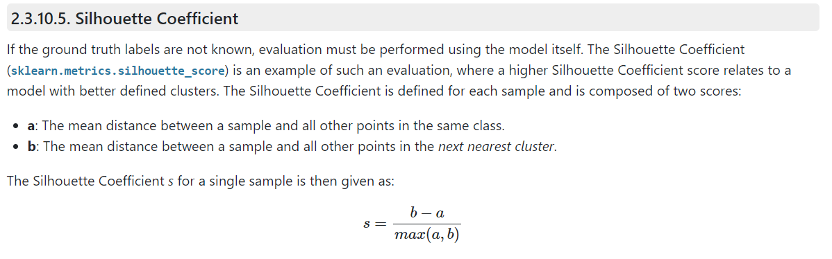
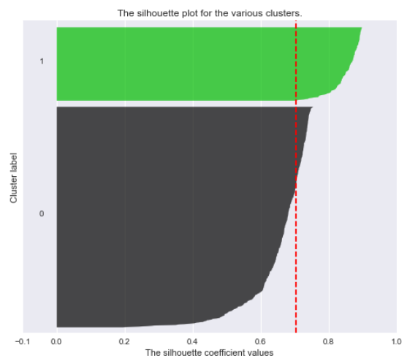
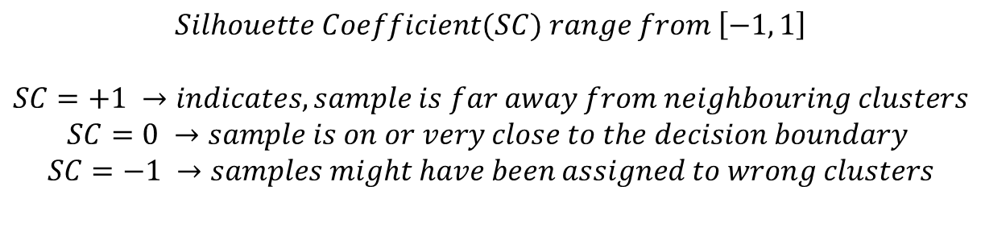
How good are the clusters? Silhouette Method
$$Silhouette Coefficient(SC) range from \left[−1, 1\right]$$
$$SC=+1 →indicates, sample is far away from neighbouring clusters$$
$$SC=0 →sample is on or very close to the decision boundary$$
$$SC=−1 →samples might have been assigned to wrong clusters$$
https://scikit-learn.org/stable/auto_examples/cluster/plot_kmeans_silhouette_analysis.html

Slide 18
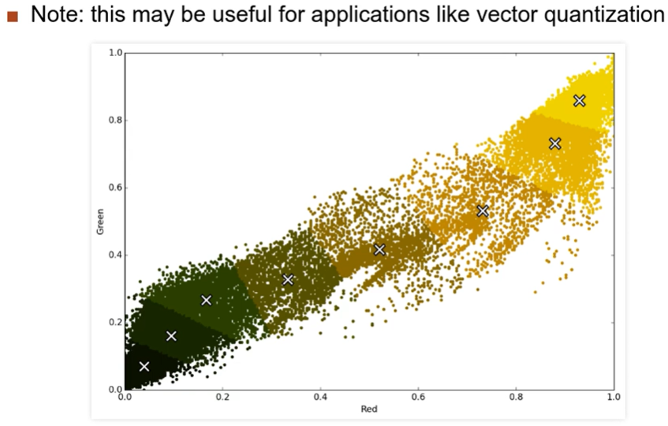
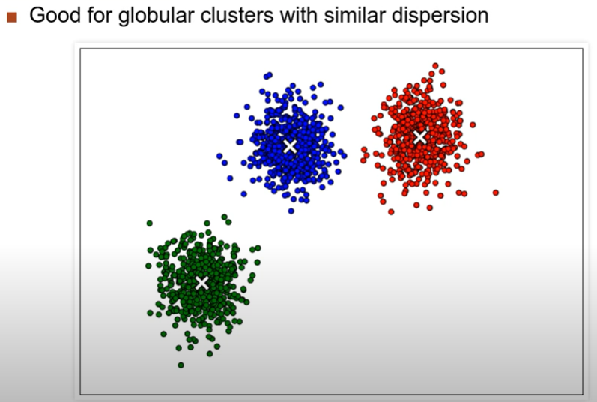
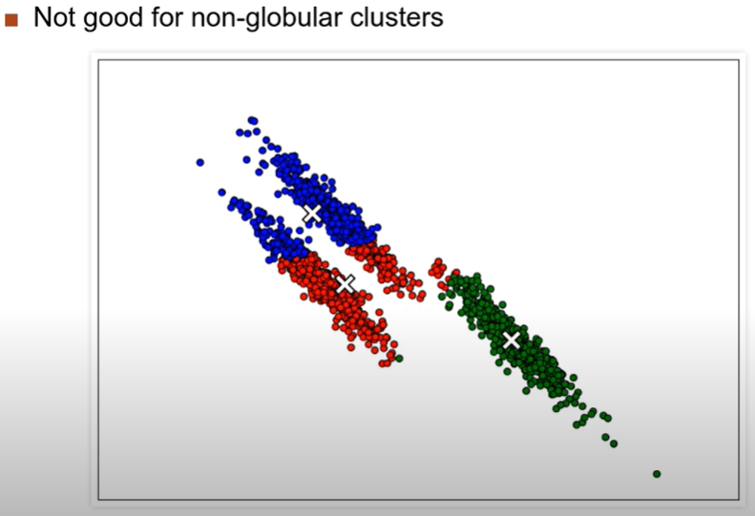
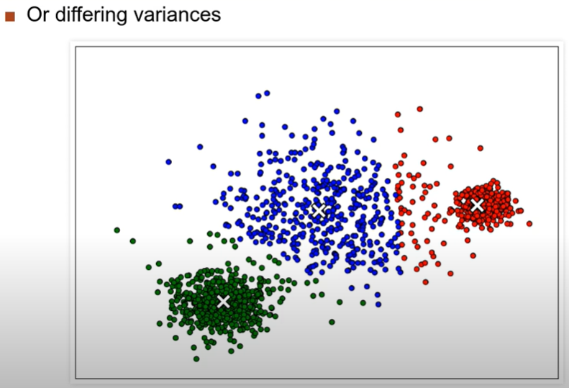
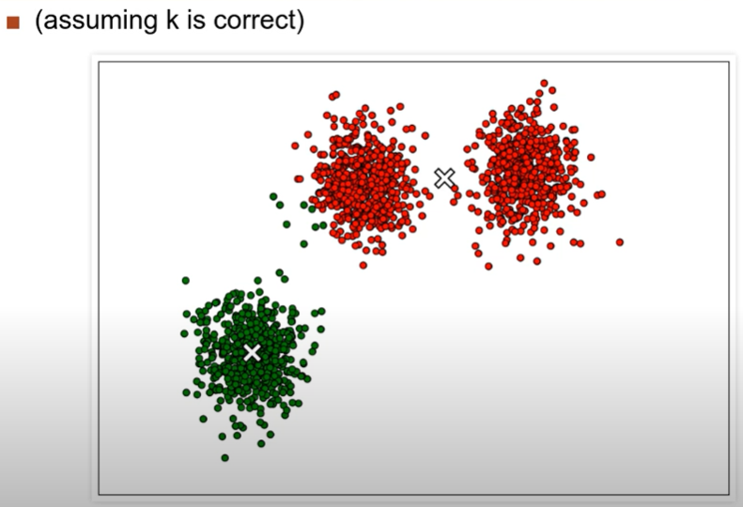
Pros and Cons of K-Family Algos

Slide 19
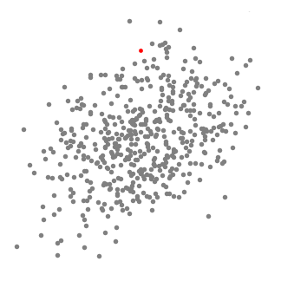
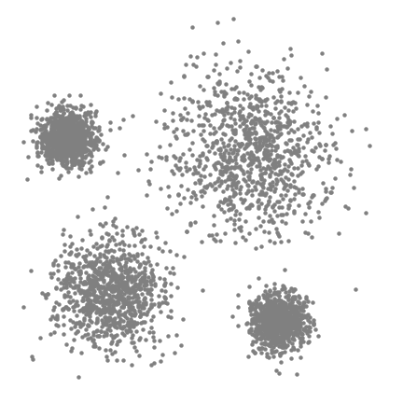
Mean Shift Algorithm
Initialize the centers randomly on the dataset
Loop:
Around each centers is a ball (determined by the bandwidth parameter), calculate the density of the center.
Update the center with the centroid calculated on the points inside the ball of the center
Until convergence

Slide 20
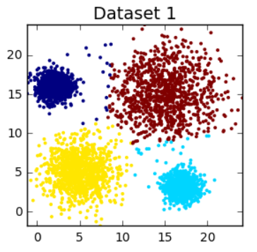
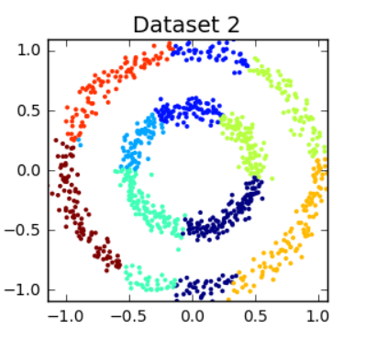
Pros and Cons of Mean Shift Clustering
No need to pre-determine the Number of Clusters
Can cluster data with varying density
Still suffers from the problem of the data being globular in shape.
Estimating bandwidth parameter is not easy.

Slide 21
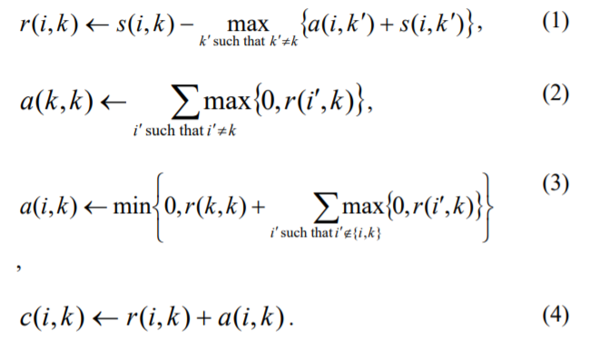
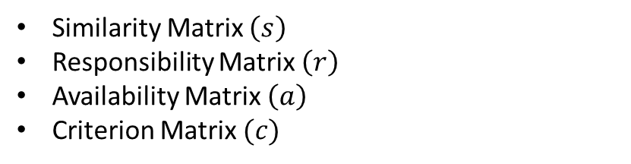
Affinity Propagation Algorithm
Affinity Propagation is based on data points choosing the exemplar points
Similarity Matrix $\left(s\right)$
Responsibility Matrix $\left(r\right)$
Availability Matrix $\left(a\right)$
Criterion Matrix $(c)$

Slide 22
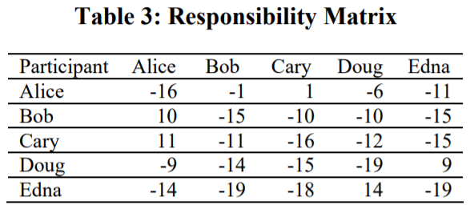
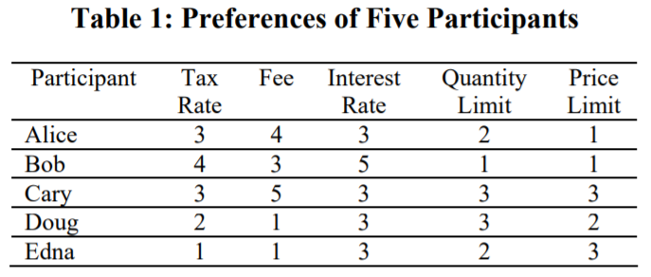
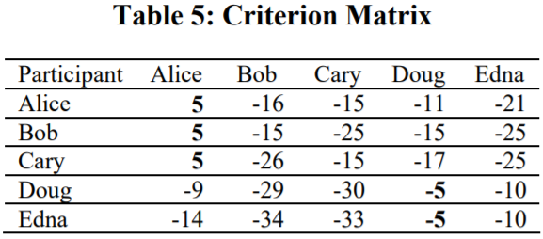
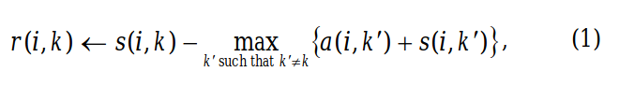
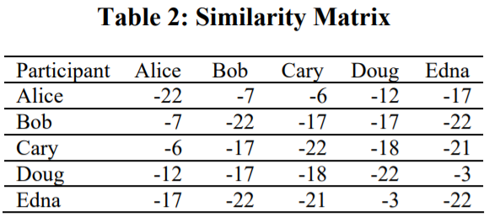
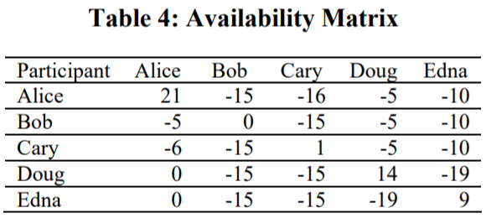
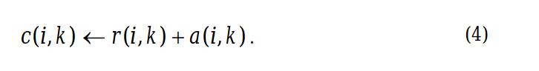
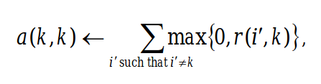
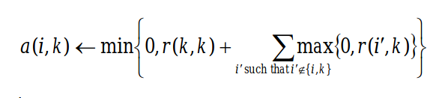
Working of Affinity Propogation
http://citeseerx.ist.psu.edu/viewdoc/download?doi=10.1.1.490.7628&rep=rep1&type=pdf

Slide 23
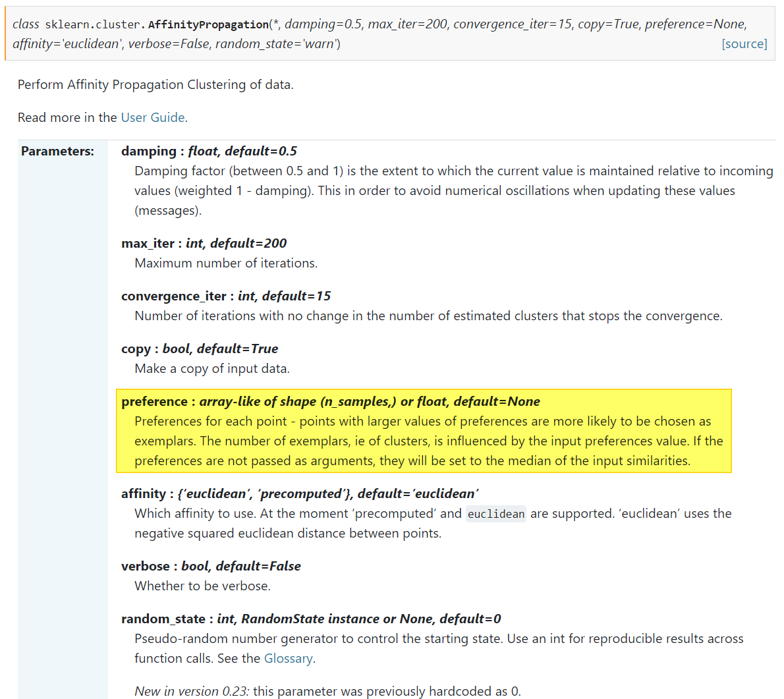
Parameters of Affinity Propagation

Slide 24
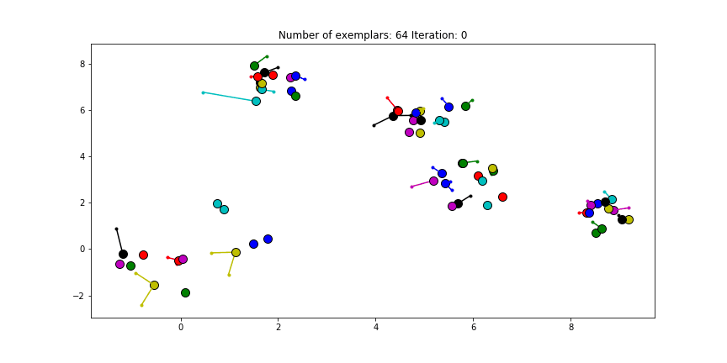





Choosing Preference is difficult
$$preference=0$$
$$preference=median(S)$$
$$preference=−70$$
$$preference=−1000$$

Slide 25
02
Graph Based Clustering

Slide 26



Spectral Clustering
Standford CS224W - Machine Learning with Graphs - Fall 2019

Slide 27







Working

Slide 28



Examples

Slide 29


Spectral Clustering in sklearn

Slide 30
Pros and Cons
Pros
Cons
Doesn’t assume the shape of the data.
Doesn’t need the actual data, can work with similarity matrix or adjacency matrix
Can be costly to compute
Nosiy dataset causes problems
Good for datasets containing inherent graph like structures

Slide 31


What will we see in Part-2
HDBSCAN
Clustering
Centroid Based Clustering
Hierarchical Based Clustering
Density Based Clustering
Graph Based Clustering

Slide 32


Clustering of 3D-data
Clustering on Compressed Representation
Auto-encoder on 3D data

Slide 33
Thank You

Slide 34
Clustering Algorithms
Part-2

Slide 35


What did we see in Part-1…
Clustering
Centroid Based Clustering
Hierarchical Based Clustering
Density Based Clustering
Graph Based Clustering

Slide 36
Agenda
01
Hierarchical Clustering Algos
04
Clustering 3D Data
Agglomerative Clustering
Ward Clustering
Autoencoder
02
Density Based Clustering
DBSCAN
OPTICS
03
HDBSCAN
Workings

Slide 37
Hierarchical Clustering

Slide 38



Agglomerative Clustering (Hierarchical Clustering)
Flat vs Hierarchical Clustering
Hierarchical Clustering
Divisive Clustering
Agglomerative Clustering
Top Down Approach
Bottom Up Approach

Slide 39









How Agglomerative Clustering Works

Slide 40




How it works….

Slide 41










Distance Measure for finding Closest Cluster
Hierarchical Clustering Playlist - Victor Lavrenko

Slide 42


Agglomerative Clustering - sklearn
Lecture 59 — Hierarchical Clustering | Stanford University
https://scikit-learn.org/stable/modules/clustering.html#hierarchical-clustering

Slide 43

Balanced Iterative Reducing and Clustering using Hierarchies -BIRCH
Existing algorithm scales poorly with processing large datasets
BIRCH algorithm is specifically used for handling large datasets by first generating compact representation of the data.
Step 1 – a rough clustering is performed – building a Clustering Feature (CF) tree
Step 2 – an arbitrary clustering algorithm is used to cluster the leaf node of CF tree
https://www.youtube.com/watch?v=PMBkL9lkoq4
https://www.youtube.com/watch?v=jALZ8dj8FXU

Slide 44




Clustering Features
DATA MINING 5 Cluster Analysis in Data Mining 4 5 BIRCH A Micro Clustering Based Approach – YouTube
https://towardsdatascience.com/machine-learning-birch-clustering-algorithm-clearly-explained-fb9838cbeed9

Slide 45


Building of the Clustering Feature Tree

Slide 46


BRICH - sklearn

Slide 47
Pros and Cons
Pros
Cons
Only works with numerical data
Insertion order affects the CF tree
Due to fixed size of the leaf nodes, final clusters may not be natural
Clusters tend to be spherical due to the radius and diameter measures
Efficient for clustering large dataset that can’t fit into the memory
Different clustering algorithms can be used on the leaf nodes

Slide 48
Density Based Clustering

Slide 49

Density Based Spatial Clustering of Applications with Noise- DBSCAN
https://www.youtube.com/watch?v=6jl9KkmgDIw

Slide 50


How does it work?

Slide 51








Workings of DBSCAN

Slide 52




Workings contd…
https://www.naftaliharris.com/blog/visualizing-dbscan-clustering/

Slide 53


Pros

Slide 54

Cons
DBSCAN is sensitive to the setting of parameters
Doesn’t handle different density clusters very well
Doesn’t work well in high dimensionality
DBSCAN is not entirely deterministic. That's because the algorithm starts with a random point. Therefore, border points that are reachable from more than one cluster can be part of either cluster
https://www.youtube.com/watch?v=sKRUfsc8zp4
https://www.youtube.com/watch?v=0Os5AydChR0

Slide 55

DBSCAN API – sklearn
https://scikit-learn.org/stable/modules/generated/sklearn.cluster.DBSCAN.html

Slide 56

OPTICS - Ordering Points to Identify the Clustering Structure
OPTICS is an extension of the DBSCAN algorithm, developed by the same authors of DBSCAN
https://www.youtube.com/watch?v=GCnsmjwV3BE&list=RDQM5kYy1aM6fgE&start_radio=1

Slide 57


Hierarchical Density-based Spatial Clustering of Applications with Noise - HDBSCAN

Slide 58


How it works?
Estimate the densities
Generate Hierarchy
Extract Clusters
https://towardsdatascience.com/a-gentle-introduction-to-hdbscan-and-density-based-clustering-5fd79329c1e8
https://hdbscan.readthedocs.io/en/latest/how_hdbscan_works.html

Slide 59



Sea vs Island

Slide 60



Generating Clusters

Slide 61






HDBSCAN - Comparison

Slide 62


HDBSCAN - Comparision

Slide 63
Clustering using Deep Learning

Slide 64




Deep Clustering
A Survey of Clustering With Deep Learning

Slide 65
Clustering of 3D Models

Slide 66


Approach
Shape-net dataset

Slide 67



Results of Autoencoder

Slide 68
Applying clustering
Let’s go to notebook…

